Slide 1
TAS152
LECTURE 20
TOPIC 4
ARTIFICIAL INTELLIGENCE ETHICS
4.1 INTRODUCTION + 4.2 NINE ETHICAL ISSUES IN ARTIFICIAL INTELLIGENCE

Slide 2
NINE ETHICAL ISSUES ASSOCIATED WITH THE USE OF AI
Unemployment
Inequality
Humanity
Artificial stupidity
Racist robots
Security
Evil geniuses
Singularity
Robot rights

Slide 3
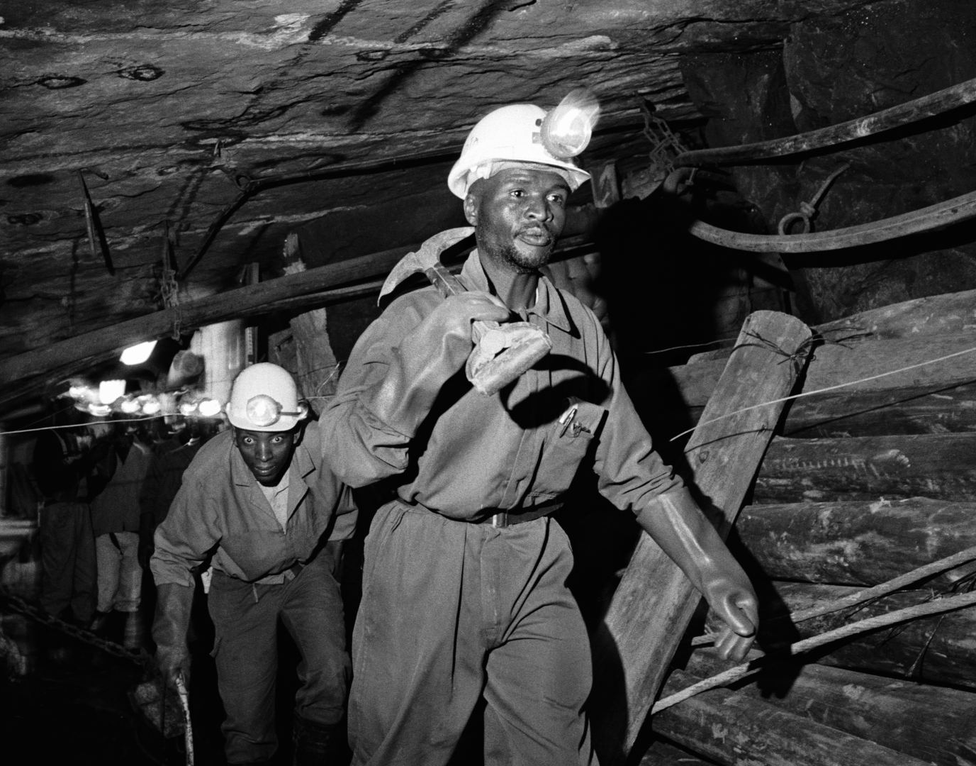
1 - UNEMPLOYMENT
Lets start with the good news...
Automated production lowers manufacturing costs, increases productivity, and increases the demand for labour.
Manufacturing facilities aren't outsourced, creates additional employment opportunities for local workers.
Case studies have shown automation can result in the workforce of a company tripling.
AI should be doing jobs that are too dangerous for humans, not painting pictures.

Slide 4
1 - UNEMPLOYMENT
Gauteng aims to use AI to solve unemployment
https://gauteng.net/news/can-ai-solve-south-africas-unemployment-problem/
Half of the world's deepest mines are in South Africa
https://www.mining-technology.com/features/feature-top-ten-deepest-mines-world-south-
africa/?cf-view
Even in the modern age, mining is incredibly dangerous
https://www.sanews.gov.za/south-africa/mining-sector-urged-prioritise-safety-workers
AI technology can help alleviate this danger
https://undark.org/2022/11/23/new-technology-aims-to-stop-an-old-danger-in-south-africas-
mines/
https://www.iol.co.za/business-report/economy/africas-mining-investment-outlook-hinges-on-ai-adoption-2edb2e9f-9cc0-4632-a78e-5b61b2b19e4f

Slide 5
1 - UNEMPLOYMENT
So why are we already seeing job losses then?
A surprisingly small amount of people are fired because their jobs have been made redundant/automated by AI.
The AI tools/tech isn't completely developed yet.
It is expensive to develop AI tools/tech.
People are losing their jobs because their employers need the money that they would have spent on their salary to invest in AI research and development.
https://archive.is/U0R89

Slide 6
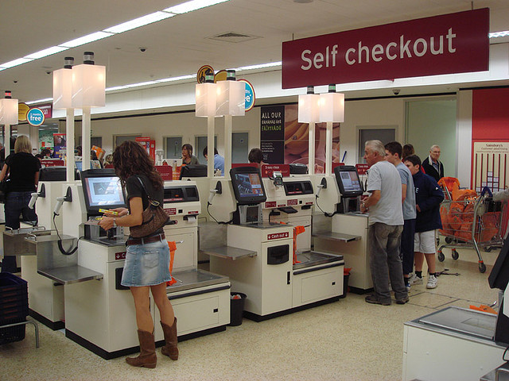
2 - INEQUALITY
Artificial intelligence has the potential to worsen existing inequalities.
"Unskilled" or "low-skilled" labour will be the first to disappear when AI becomes mainstream.
Not all instances of automation using artificial intelligence will lead to a situation where the workers can be retrained.

Slide 7
2 - INEQUALITY
What are some potential solutions?
Universal basic income
Tax reform
Education reform
What are the arguments against the above solutions?
Loss of purpose and incentive
Distrust in governing bodies
Existing inequality needs to be resolved first

Slide 8
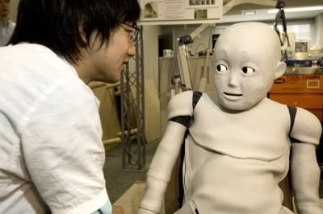
3 - HUMANITY
Humans are social creatures.
We crave interaction, validation, companionship and love.
Natural language processing (NLP) is a type of AI.
The most well-known NLP invention is the large language model (LLM) i.e. ChatGPT.
LLMs can be used to create "social bots"
Social bots are artificial intelligence tools that mimic human socialization online with the goal of fooling people into thinking there is a real human behind the screen.

Slide 9

3 - HUMANITY
Social bots have many uses:
Customer service
Therapy or mediation purposes
Video games
Virtual "companions"
https://www.theguardian.com/commentisfree/2024/jan/13/ai-girlfriend-chatbots
Social bots can easily be weaponised and when set free on social media, they can have a very serious real world impact:
Election interference
Spreading of misinformation or hateful rhetoric

Slide 10
3 - HUMANITY
How to spot a bot on Twitter:
Humans re-tweeted more frequently than bots.
Humans replied to tweets more frequently than bots.
Tweets posted by humans included more mentions than tweets posted by bots.
Tweets posted by humans were generally shorter than tweets posted by bots.
Tweets posted by humans gradually decreased in length as the sessions progressed, while no similar pattern was detected among tweets that were posted by bots.
Some other giveaways include:
Incorrect factual information
Repetitive phrasing
Hallucinations.

Slide 11
4 – ARTIFICIAL STUPIDITY
Human intelligence and machine intelligence both emerge from a process of focused learning.
Machine intelligence is learned by presenting a machine with many different ‘patterns’.

Slide 12

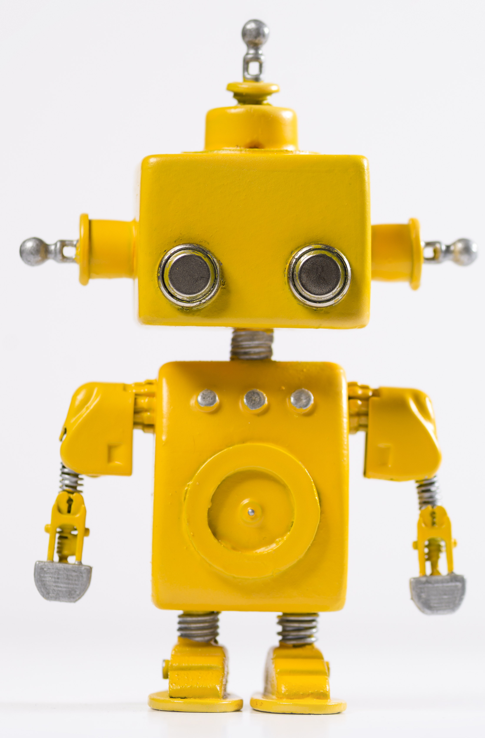

4 – ARTIFICIAL STUPIDITY
The machine is trained to associate certain patterns with certain outcomes
THESE
ARE
TRIANGLES
THESE
ARE
ELLIPSES
With enough training the machine begins to understand what parts of the pattern is "important" and which parts are not.
I know the colour doesn't affect the outcome
I know that triangles
have sharp points.
Eventually the machine can make predictions on the outcome of patterns it has never seen before:
That is a triangle

Slide 13
4 – ARTIFICIAL STUPIDITY
So what is artificial stupidity then?
That is a triangle
That is an ellipses
That is a triangle

Slide 14
4 – ARTIFICIAL STUPIDITY
The effects of artificial stupidity ranges from silly to potentially illegal
https://tech.co/news/list-ai-failures-mistakes-errors
How do we guard against artificial stupidity?
Continuous training and testing
Strictly controlling and validating the patterns that the AI sees.

Slide 15
5 – RACIST ROBOTS
Unless all possible instances of the relevant data are included in the training dataset, the resulting algorithms will unavoidably be biased.
The origins of bias can be complicated and therefore it isn't a trivial problem to solve.
https://www.theguardian.com/technology/2024/feb/28/google-chief-ai-tools-photo-diversity-offended-users
https://www.aljazeera.com/news/2024/3/9/why-google-gemini-wont-show-you-white-people#:~:text=Critics%20also%20say%20that%20generative,to%20generate%20images%20of%20themselves.

Slide 16
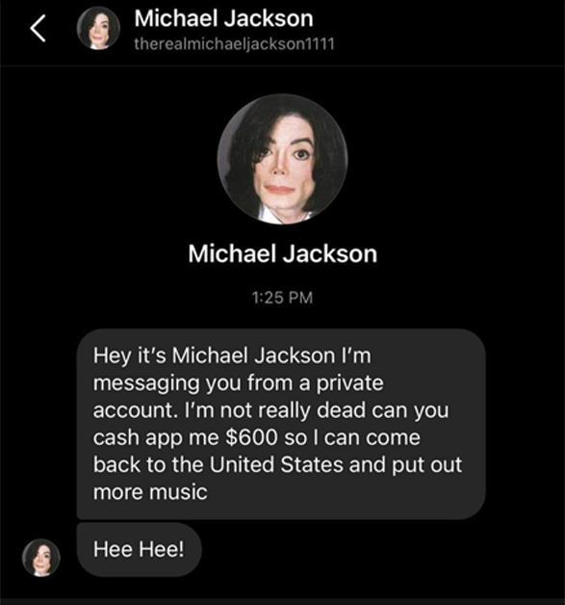
6 – SECURITY
Threats presented by the malicious use of AI technologies:
Cyberattacks
Physical security, e.g. drone attacks
Political security, e.g. circulation of propaganda and manipulated videos.

Slide 17
6 – SECURITY
Countermeasures:
Disclosure and remediation of code vulnerabilities
Encryption of documents containing sensitive information
Providing certificates of authenticity for images and video clips
Alerting the public to fake news
Regulating the development of military hardware
Prohibiting the sale of lethal autonomous weapons
https://www.sdxcentral.com/articles/analysis/the-dark-side-of-chatgpt-hackers-tap-wormgpt-and-fraudgpt-for-sophisticated-attacks/2023/08/
https://www.youtube.com/watch?v=29ECwExc-_M

Slide 18
7 – EVIL GENUISES
How can we quantify how effective an AI really is?
How do we know that it's actually "understanding" the data?
Explainable AI (XAI)
What are some examples of XAI?
Heatmap explanations
Decision tree explanations
Counterfactual explanataions

Slide 19
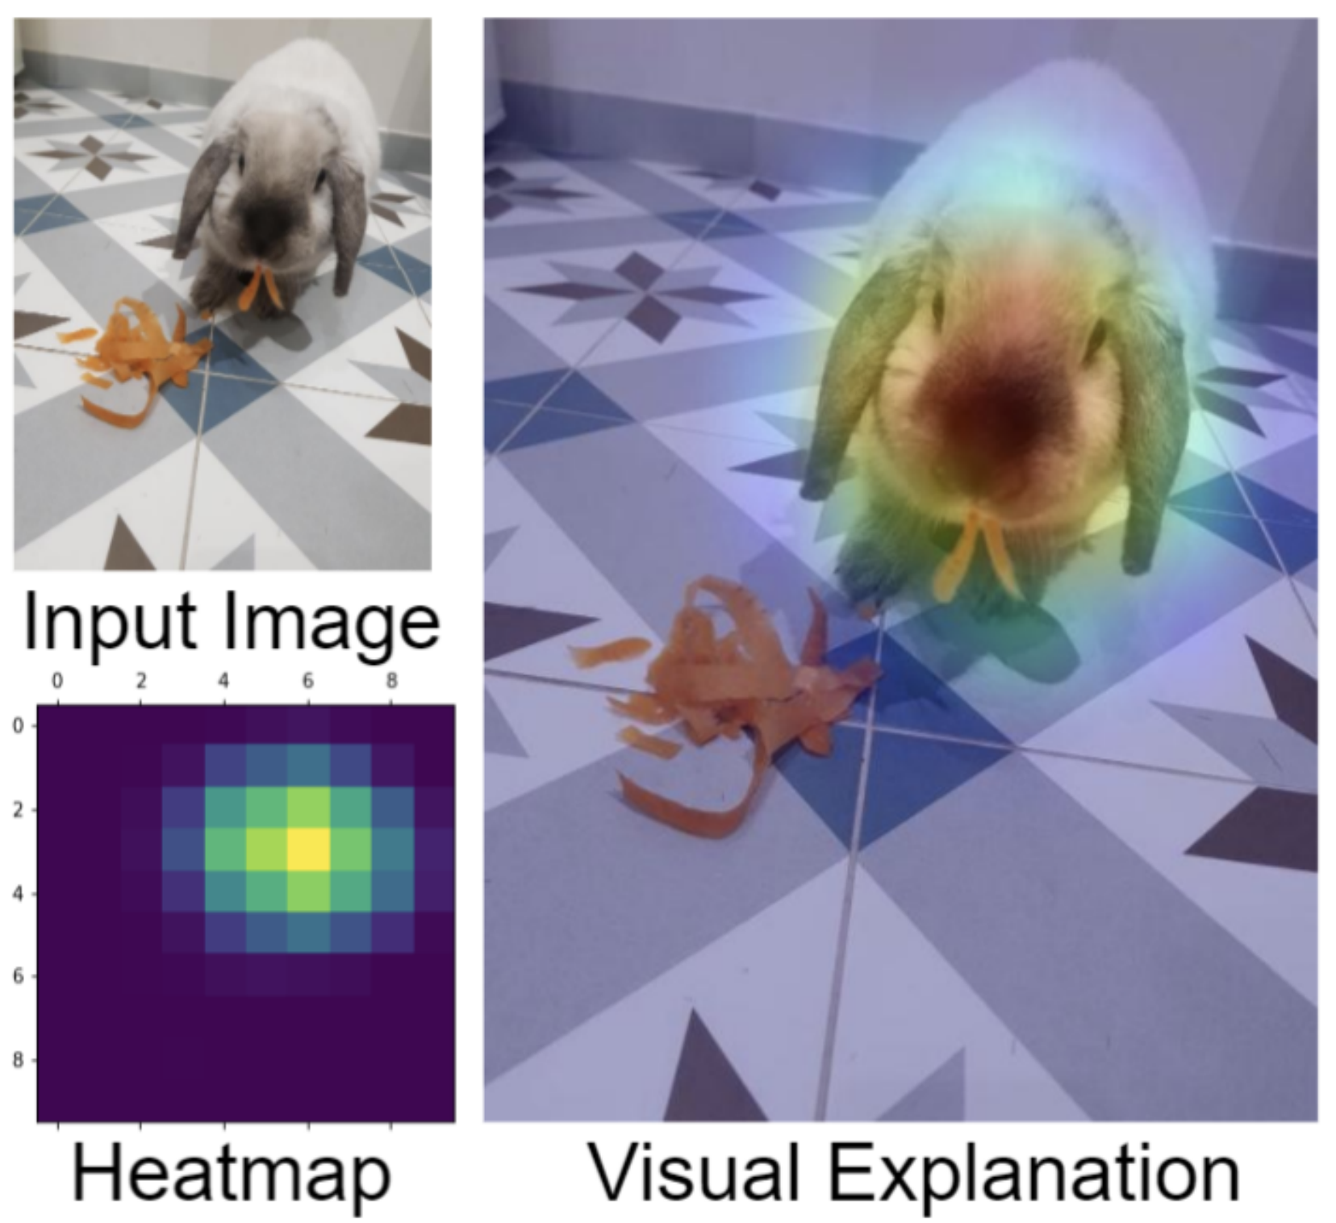
7 – EVIL GENUISES
Heatmap explanations: Shows which part of the image the AI is "focusing" on.

Slide 20
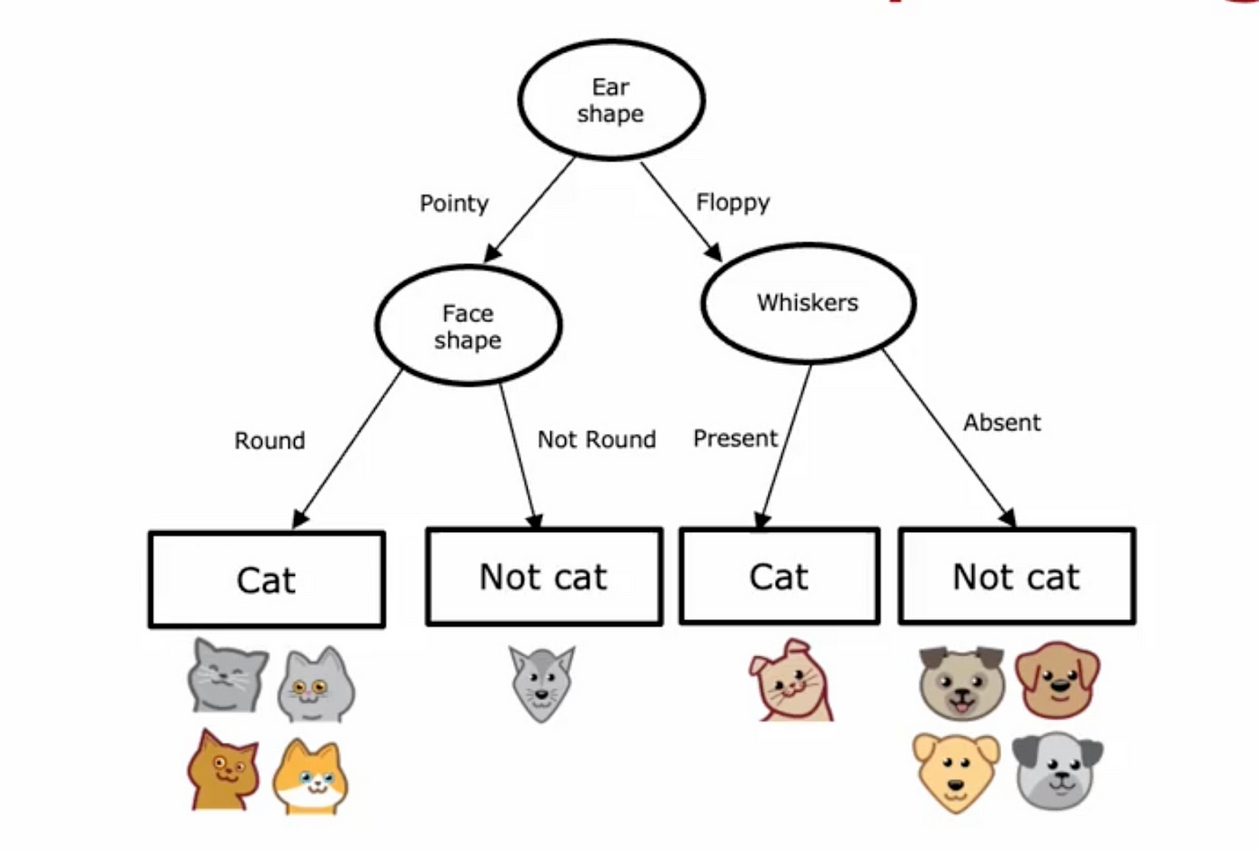
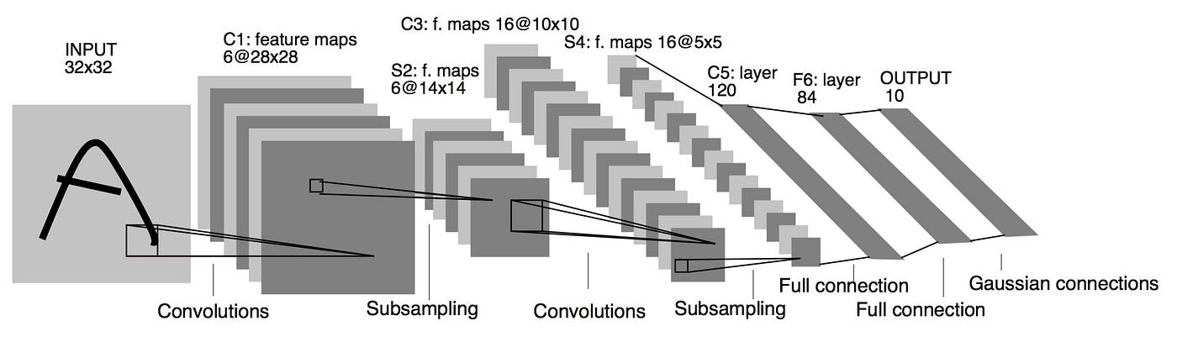
7 – EVIL GENUISES
Decision tree explanations: Most AI tools are not comprehensible, but decision trees are easily understandable. You can explain the AI tool, by modelling it as a decision tree

Slide 21
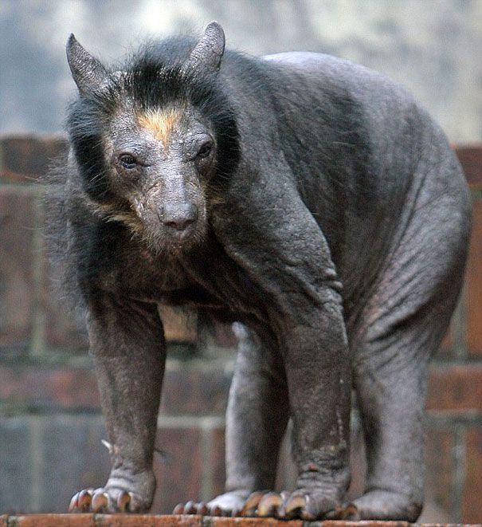
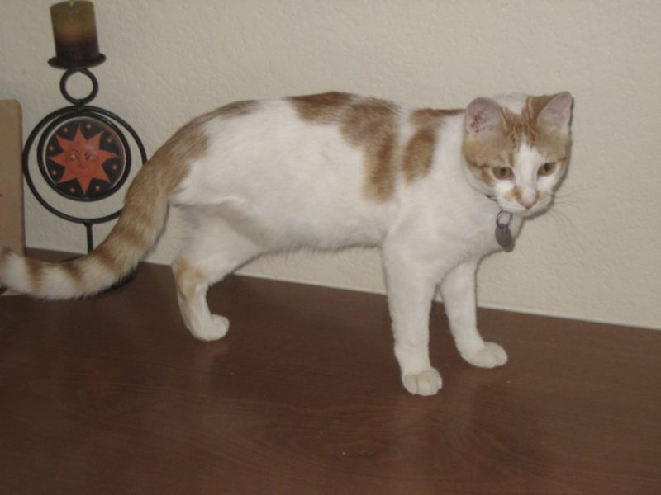
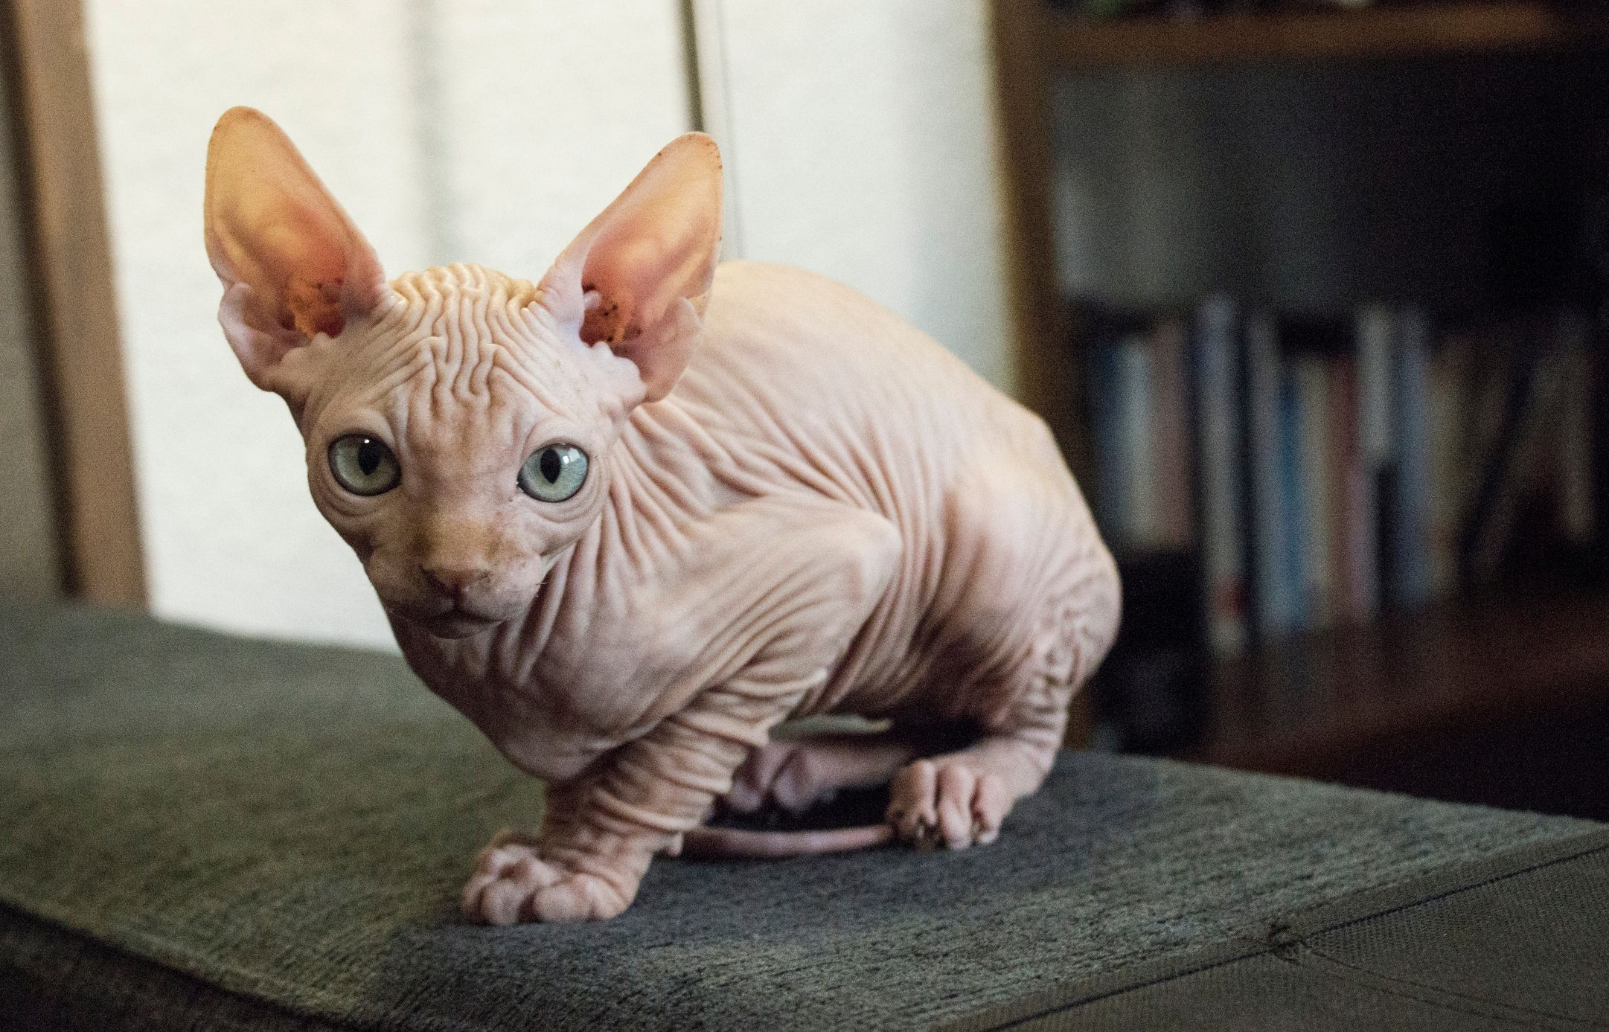
7 – EVIL GENUISES
Counterfactual explanations: The AI tool is interrogated with "what if" statements, to better understand how it works i.e. "the toddler method"
What if it has pointy ears and whiskers but only three legs?
What if it has pointy ears and whiskers but only no fur?
What if it has pointy ears and no fur and no whiskers?
Still a cat.
Still a cat.
Not a cat

Slide 22
NINE ETHICAL ISSUES ASSOCIATED WITH THE USE OF AI
Unemployment
Inequality
Humanity
Artificial stupidity
Racist robots
Security
Evil geniuses
Singularity
Robot rights

Slide 23
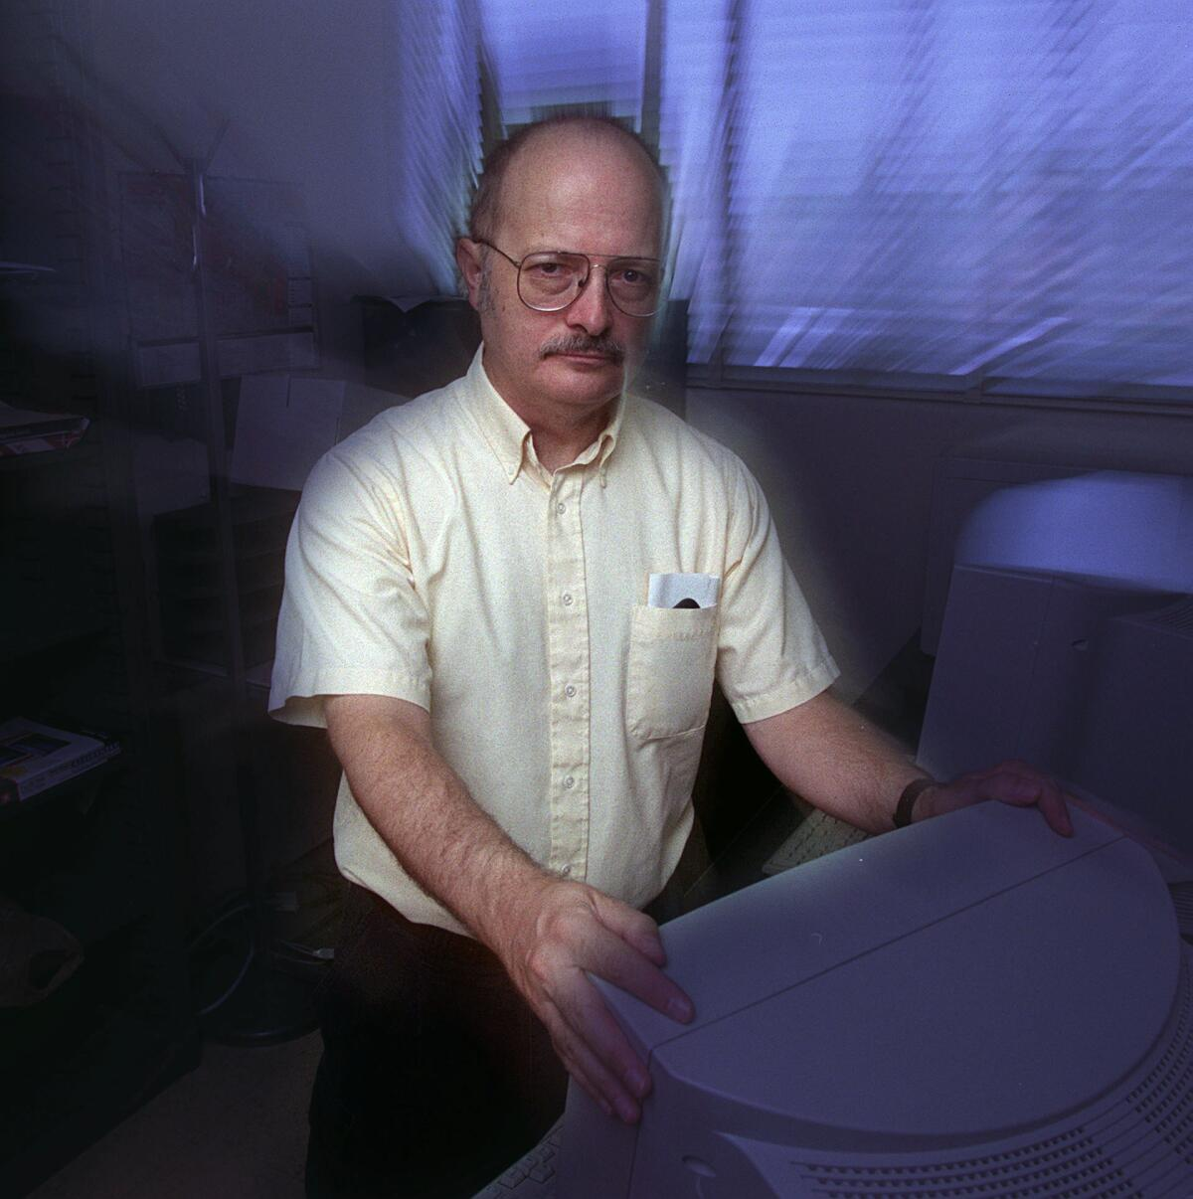
8 – SINGULARITY
What is the singularity?
First described by Vernon Vinge (SciFi author)
The point at which humans create an intelligence that exceeds human intelligence.
The obsolecence of the human race.
https://ntrs.nasa.gov/citations/19940022856

Slide 24
8 – SINGULARITY
Humans have always been able to dominate other species, whether animals or plants.
We can farm, restrain, contain and outwit all other intelligences we've encountered so far.
Advanced AI machines will have learned to defend themselves against humans by self-modifying the algorithms that determine their own behaviour
https://www.linkedin.com/pulse/singularity-happen-noon-july-1st-2024-pete-edstrom-t7xrc#:~:text=The%20singularity%20refers%20to%20a,intelligence%20will%20surpass%20human%20intelligence.

Slide 25
9 – ROBOT RIGHTS
Artificial intelligence, from the start, has taken inspiration from nature
Neural networks model the human brain
Another type of AI is called genetic algorithms (GAs)
How do GAs work?
You have an initial population of individuals
Each individual has a unique chromosome
The chromosome represents the individual's behaviour
The population "evolves" over a certain number of generations
Evolution is driven by reproduction and mutation
We only let "good" individuals reproduce
Eventually we are left with a more homogenous population, where the individuals have a certain type of desirable behaviour

Slide 26
9 – ROBOT RIGHTS
Future generations of humans may perhaps be faced by a new set of ethical questions needing to be resolved.
Have chatbots become self-aware?
https://techxplore.com/news/2023-09-chatbot-self-awareness.html
How do we test for self-awareness?
https://www.popularmechanics.com/technology/robots/a60606512/claude-3-self-aware/
What does the term "sentience" even refer to?
https://www.psychologytoday.com/us/blog/finding-purpose/202306/what-would-it-take-to-build-sentient-ai a

